Slide 1
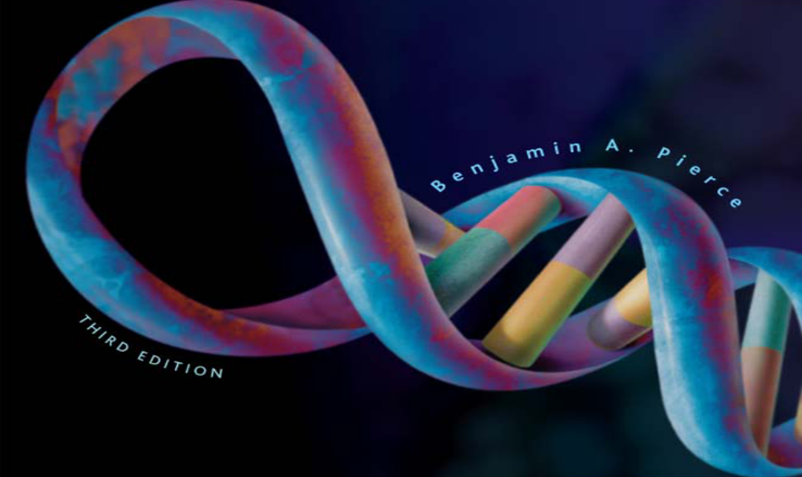
23 | Cancer Genetics
Notes:
Cell proliferates without control

Slide 2
Cancer Is a Group of Diseases Characterized by Cell Proliferation
Every year cancer kills one of every five people in US
Cancer is not a single disease – rather it is a heterogeneous group of disorders characterized by the presence of cells that do not respond to the normal control of division

Slide 3
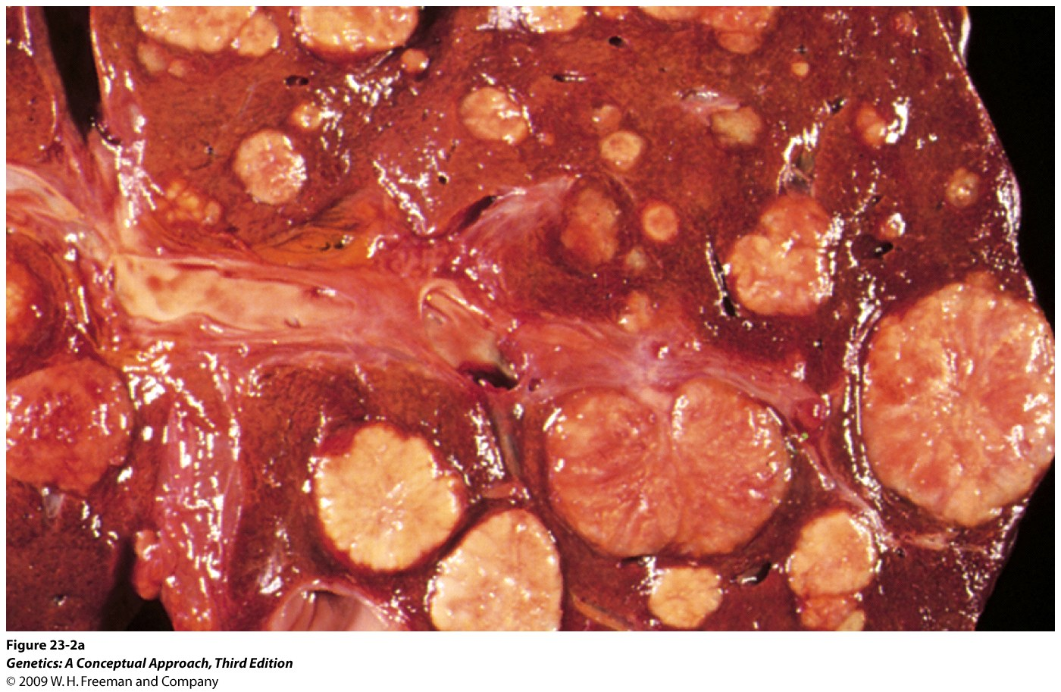
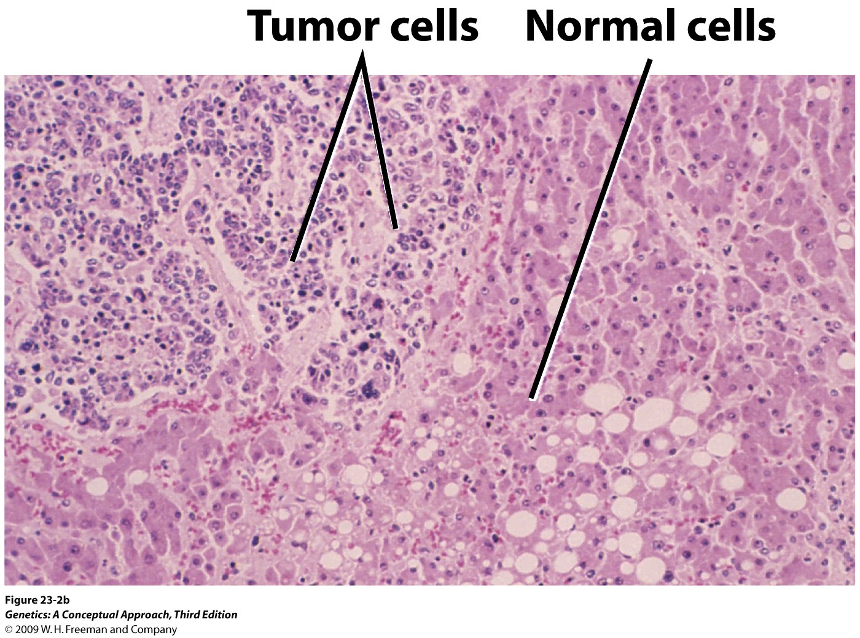
Cancer cells divide rapidly and crowd out normal cells and eventually rob healthy tissues of nutrients
The cells of advanced tumor can separate and travel to distant sites of the body – develop into new tumor – metastatic tumors
Metastatic lung tumor growing on a human liver

Slide 4
Internal and external signals control cell grow, division, maturation, and death
Normal cell receives both, inhibitory and stimulatory signal – delicate balance between these opposing forces
Disruption of one or more of these signals – abnormally high rate of proliferation - tumor
  Benign tumor: the tumor remains localized.
  Malignant tumor: tumor cells invade other tissues.
    Metastasis: the tumor cells induce secondary tumors.

Slide 5
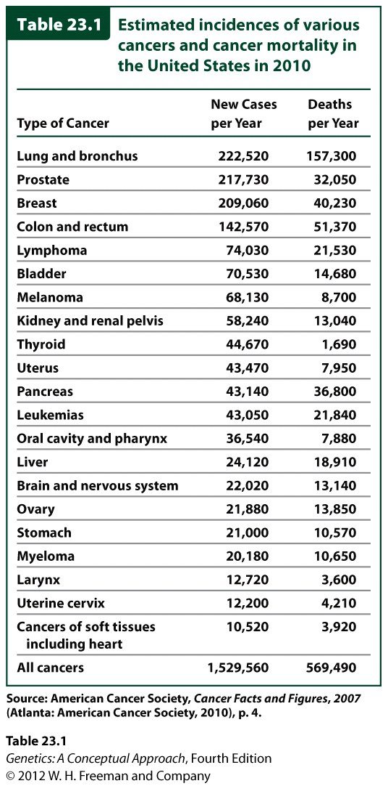

Slide 6
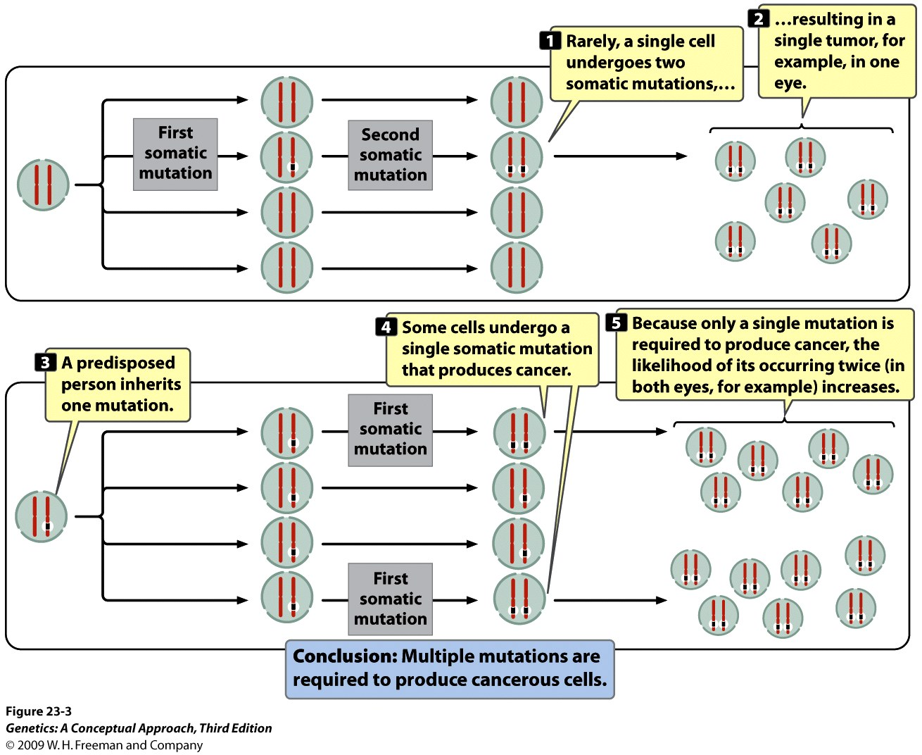
Cancer as a Genetic Disease
- The most cancers arise from defects in DNA
- Knudson proposed a model to explain the genetic bases of cancer (1971)
Retinoblastoma results from two separate genetic defects, both of which are necessary for cancer development

Slide 7
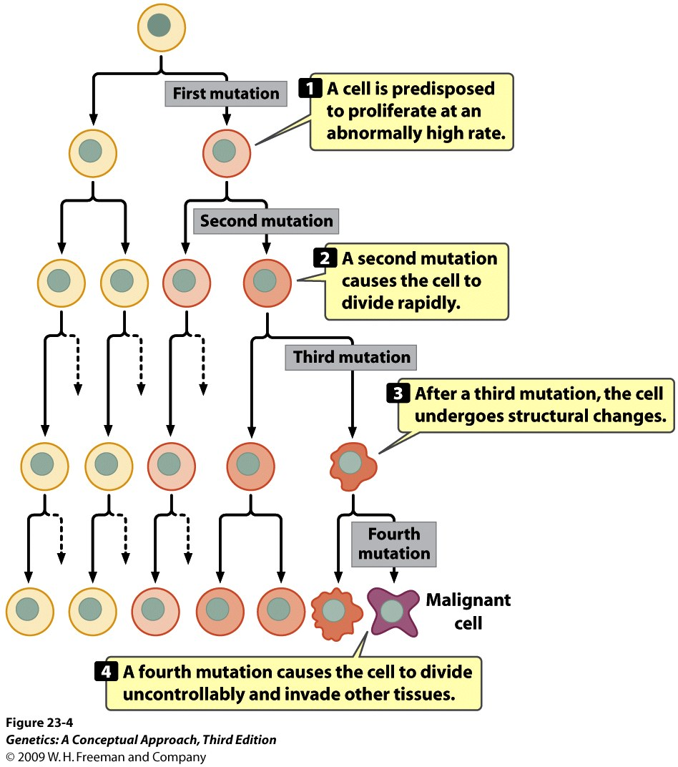
The clonal evolution of tumors:
The tumor cells acquire more mutations that allow them to become increasingly more aggressive in their proliferate properties

Slide 8
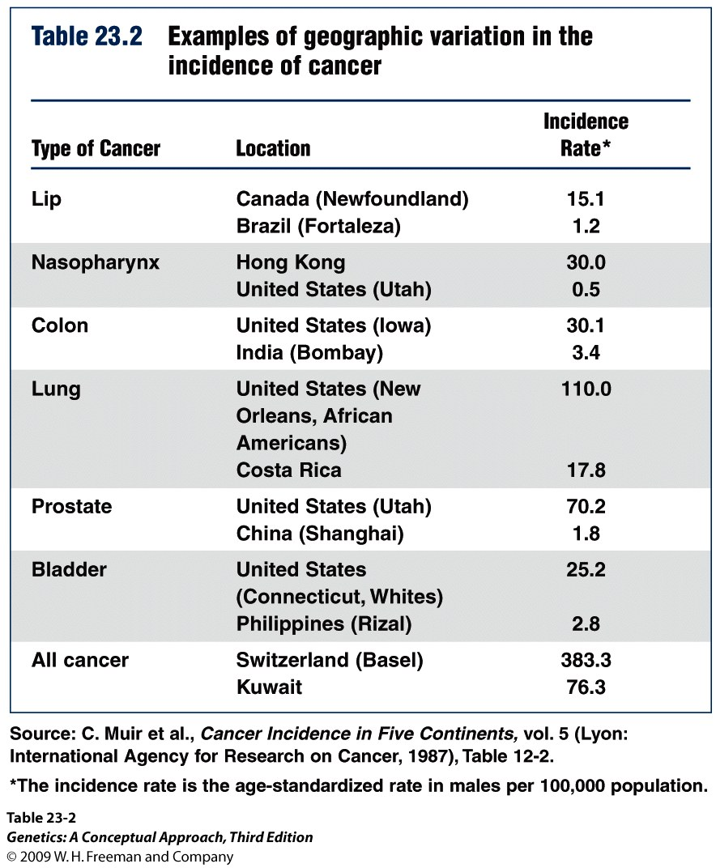
Role of Environmental Factors in Cancer
Some examples of environmental factors associated with cancer:
- Smoking
- Benzene
- PCBs (polychlorinated
biphenyls)
- UV, ionizing radiation
- Viruses
Somatic mutations

Slide 9
Mutations in a Number of Different Types of Genes Contribute to Cancer
The signals that regulate cell division fall to two basic types:
1. stimulate cell division (acceleration)
2. Inhibit cell division (brake)
Mutation in DNA repair genes can increase rate of mutations in these genes (bad mechanics)

Slide 10
Oncogene: dominant-acting stimulatory genes that cause cancer (first discovered src – isolated from the Rous sarcoma virus)
All normal cells carry DNA sequences closely related to oncogenes: Proto-oncogenes (responsible for basic cellular functions; when mutated, they become oncogenes)
Tumor suppressor genes: Inhibit cancer and recessive acting; when mutated, normal cells become cancerous.
Notes:
P53

Slide 11
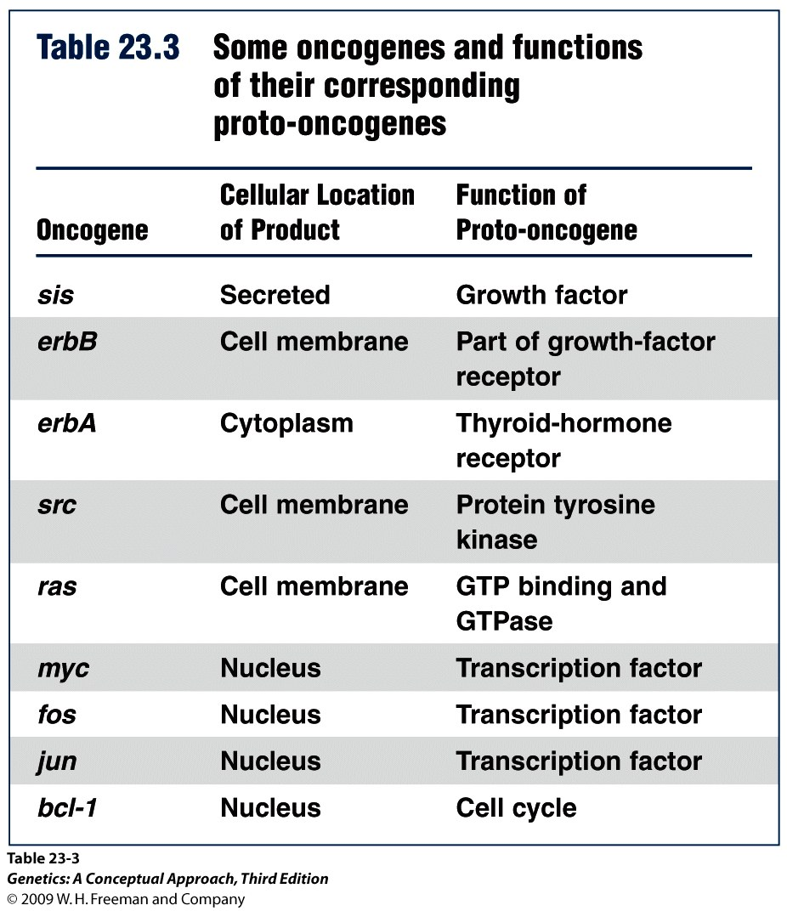

Slide 12
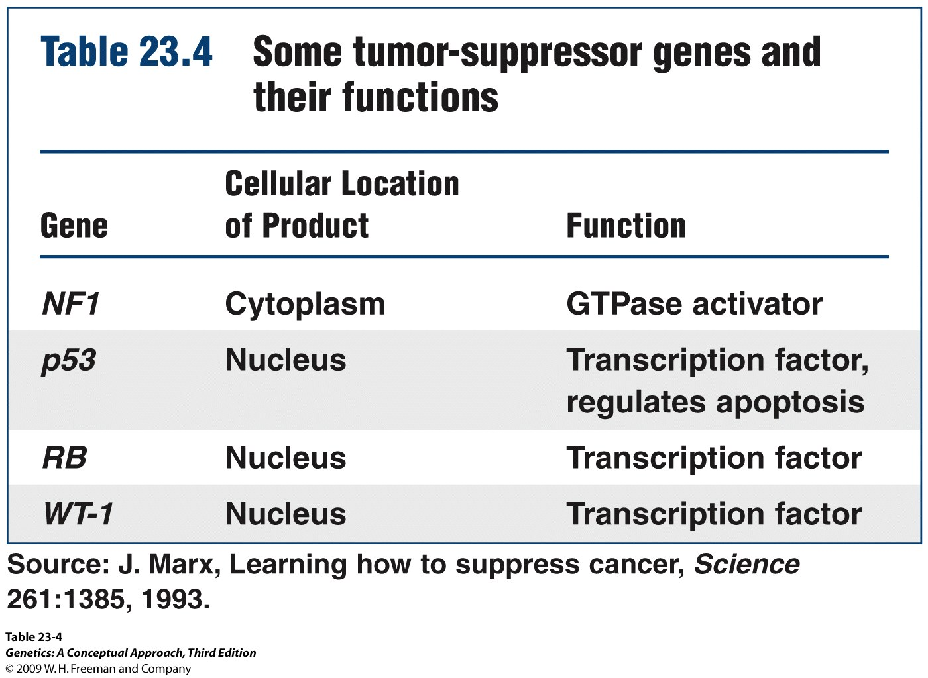

Slide 13
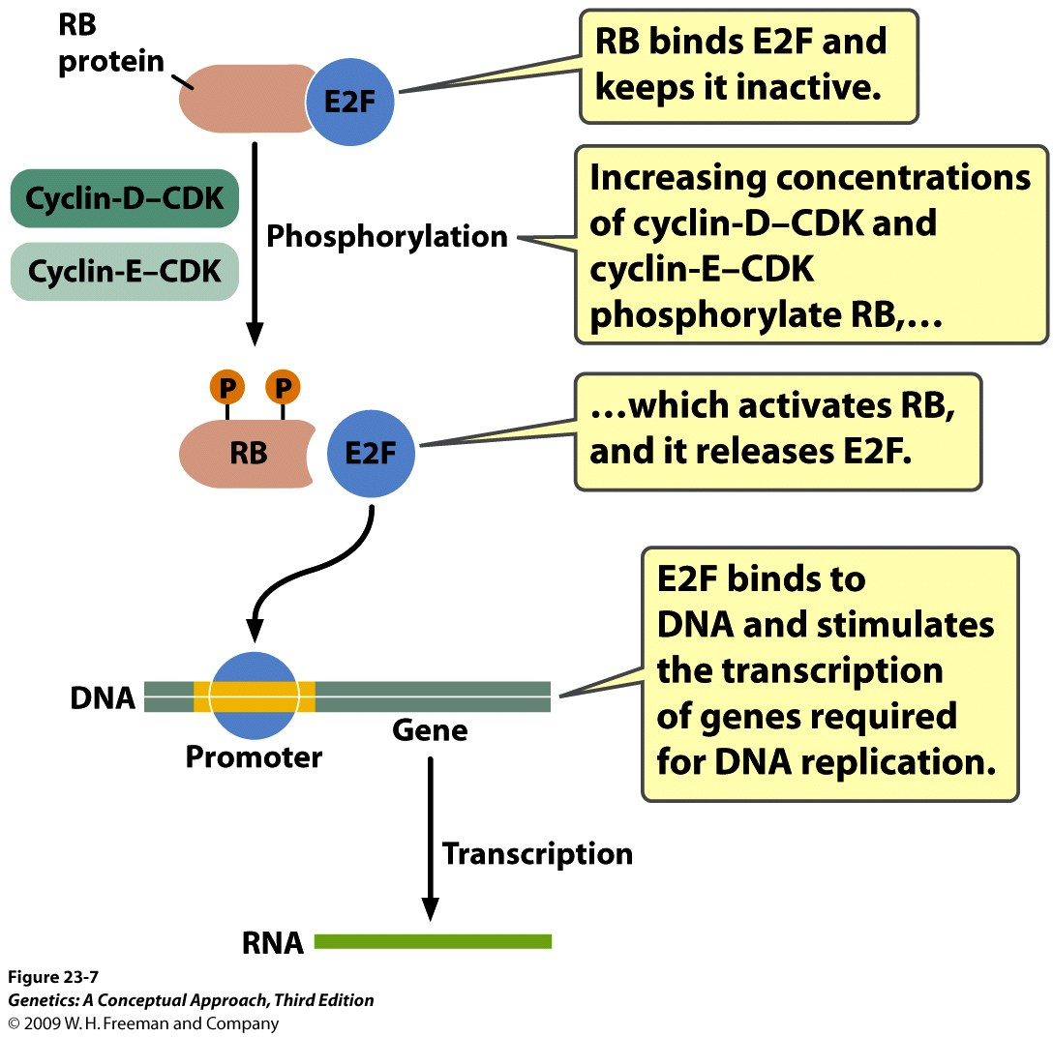
Genes That Control the Cycle of Cell Division
Key events of the cell cycle are controlled by cyclin-dependent kinases (CDKs)
The RB protein helps control the progression through the G1/S chekpoint by binding transcription factor E2F

Slide 14
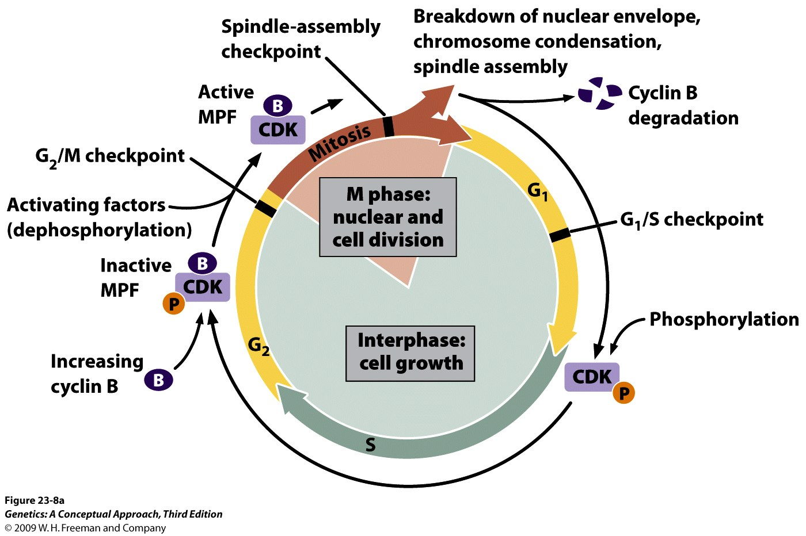
The G2/M transition is regulated an a similar way by cyclin B, which combines with SDK and form an inactive complex: Mitosis-promoting factor (MPF)

Slide 15
Concept Check 1
What would be the most likely effect of a mutation that caused cyclin B to be unable to bind to CDK?
  Cells pass through the G2/M checkpoint and enter mitosis even when DNA has not been replicated.
  Cells never pass through the G1/S checkpoint.
  Cells pass through mitosis more quickly than unmutated cells do.
  Cells fail to pass through the G2/M checkpoint and do not enter into mitosis.

Slide 16
Concept Check 1
What would be the most likely effect of a mutation that caused cyclin B to be unable to bind to CDK?
  Cells pass through the G2/M checkpoint and enter mitosis even when DNA has not been replicated.
  Cells never pass through the G1/S checkpoint.
  Cells pass through mitosis more quickly than unmutated cells do.
  Cells fail to pass through the G2/M checkpoint and do not enter into mitosis.
Notes:
Cyclin B needed to pass through G2/M checkpoint

Slide 17
Whether cell pass through cell cycle and continue to divide is influenced by numerous Internal and external signals initiated by hormones and growth factors
Signal-transduction pathways
  A cascade of intracellular reactions
  Defects in signal-transduction pathways are often associated with cancer

Slide 18
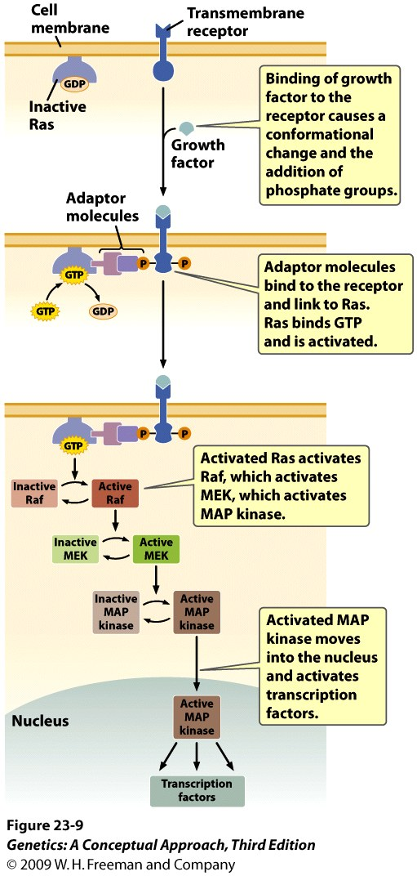
The Ras signal-transduction pathway conducts signals from growth factors and hormones to the nucleus and stimulate the cell cycle. Mutation in this pathway often contribute to cancer
Notes:
Figure 23.9 The Ras signal-transduction pathway conducts signals from growth factors and hormones to the nucleus and stimulates the cell cycle. Mutations in this pathway often contribute to cancer. MEK is another protein in the Raf signal-transduction pathway.

Slide 19
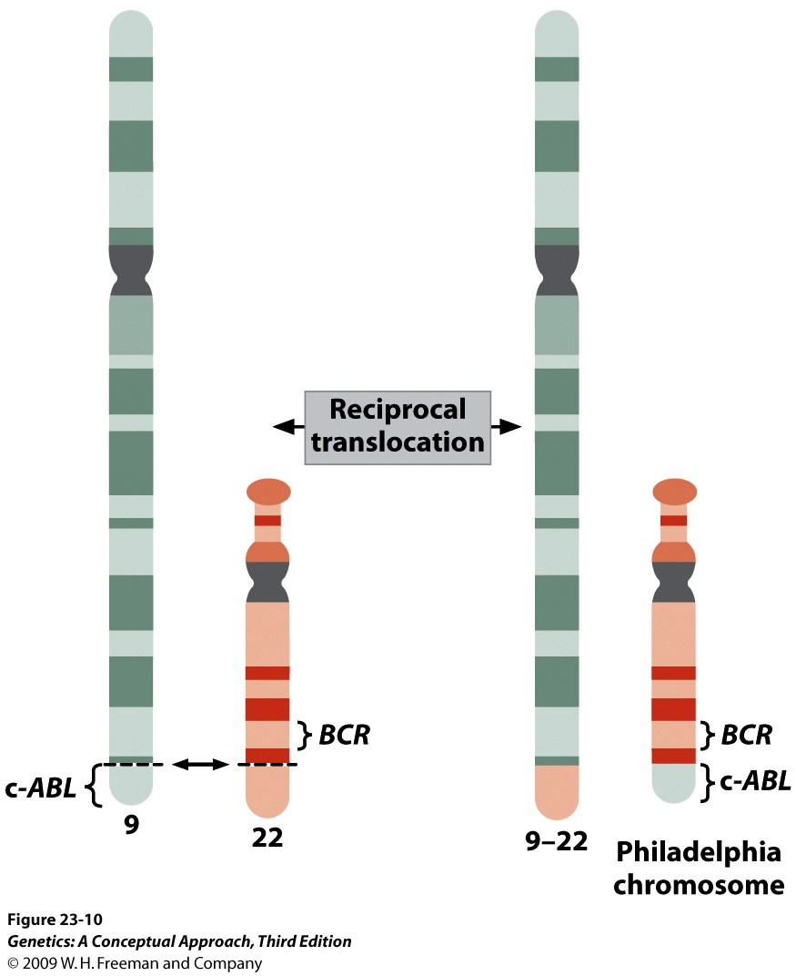
Mutations in DNA repair genes: allow accumulation of multiple mutations in a single cell
May also contribute to the generation of chromosome rearrangements and genomic instability
Example: A reciprocal
translocation between
chromosome 9 and 22
causes chronic myelogenous
leukemia.

Slide 20
Viruses Are Associated with Some Cancers
DNA viruses: HPV – 70% of cervical cancers are caused by HPV-16 and HPV-18
- Produce a protein that inactivates
RB and p53
Retroviruses (HTLV-1) cause cancer by
  mutating and rearranging proto-oncogenes
  inserting strong promoters near proto-oncogenes

Slide 21
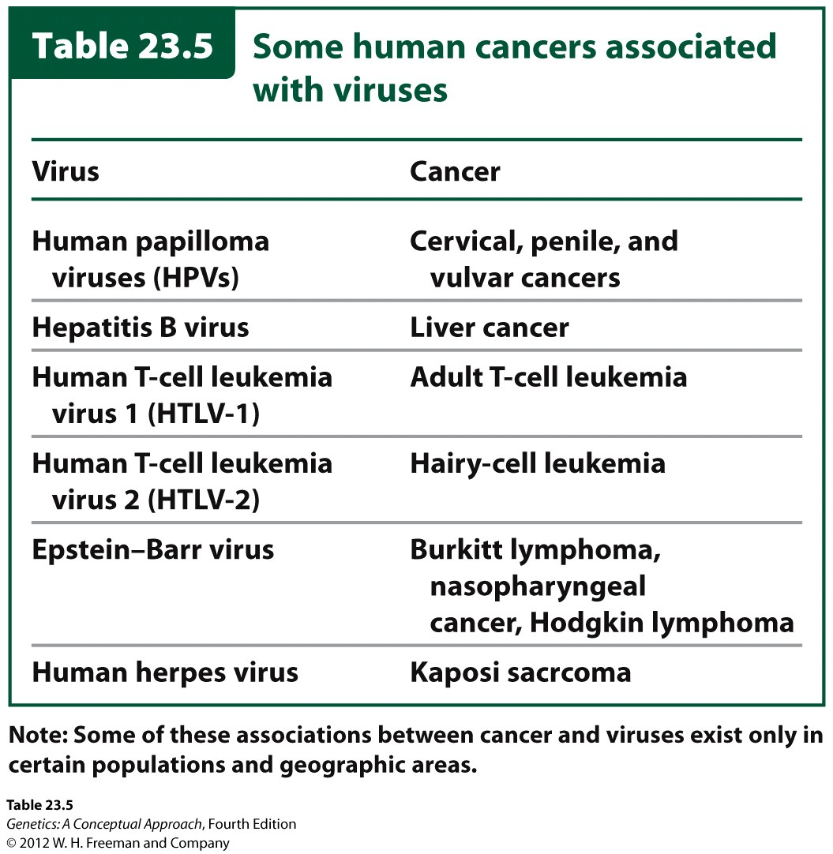

Slide 22
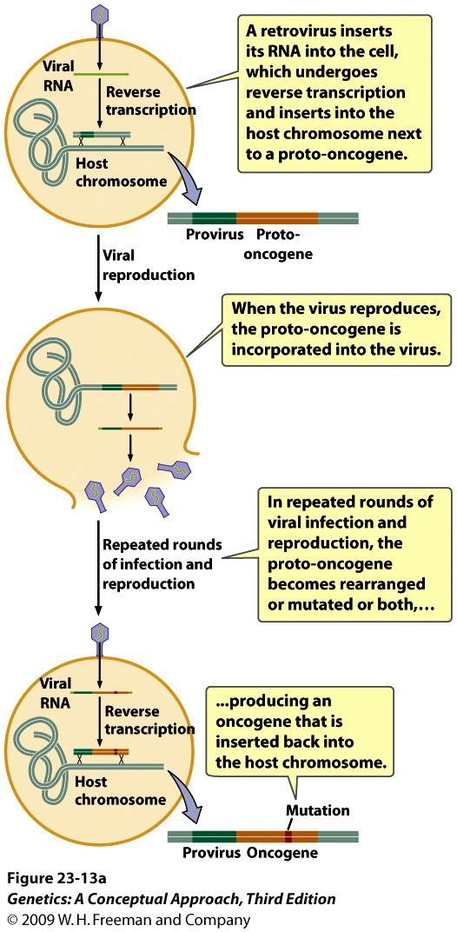
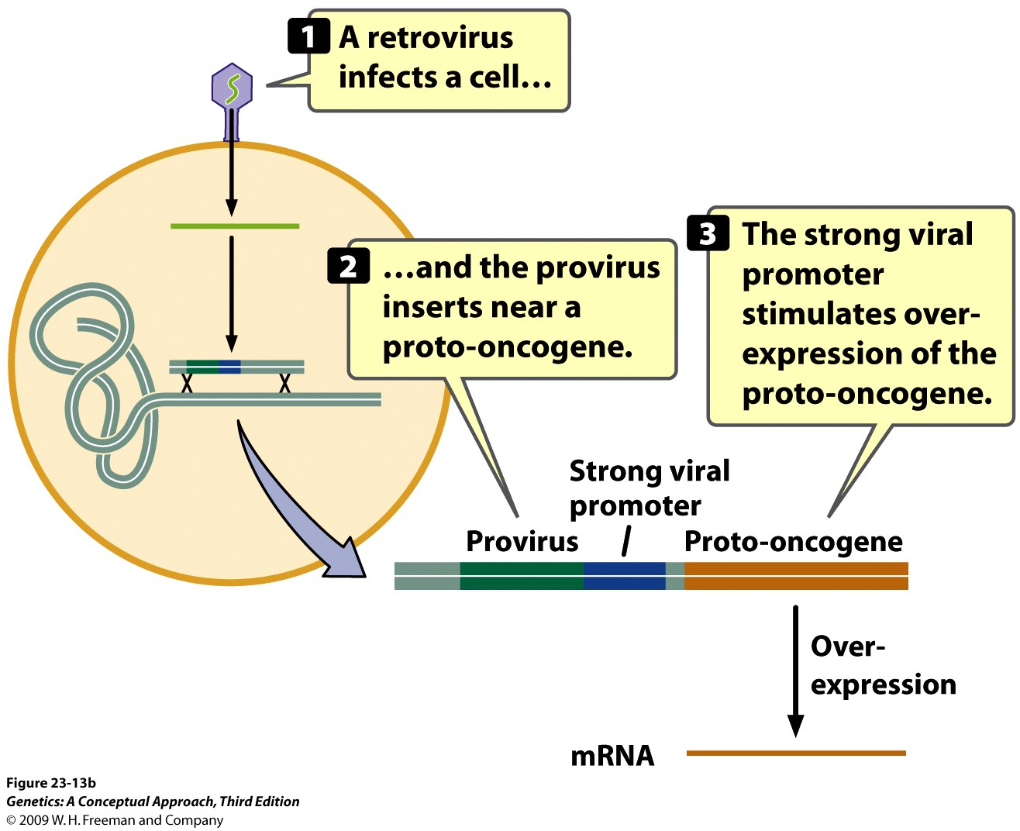
Mutation and rearrangement of proto-oncogene
Inserting strong promoters near proto-oncogene
Notes:
Figure 23.13a Retroviruses cause cancer by (a) mutating and rearranging proto-oncogenes and (b) inserting strong promoters near proto-oncogenes.

Slide 23
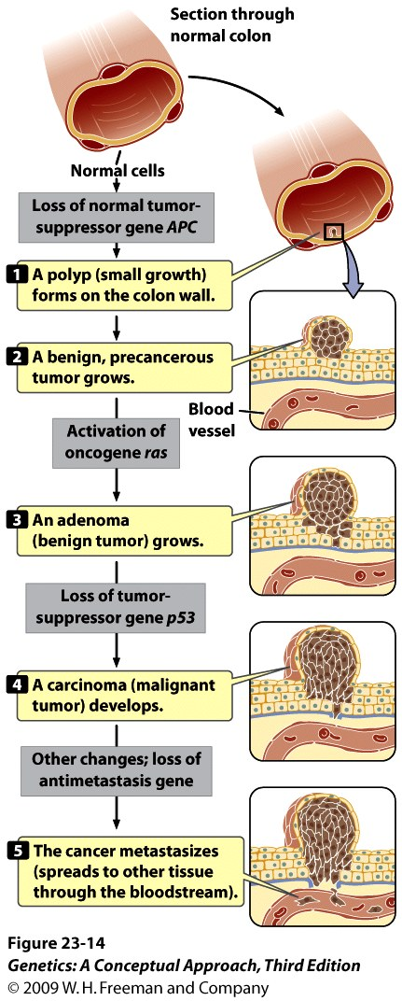
Colorectal Cancer Arises Through the Sequential Mutation in Multiple Genes

